Slide 1


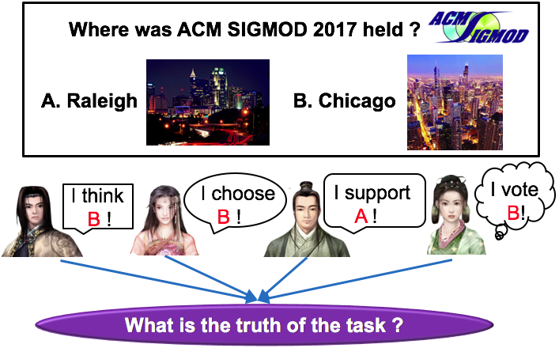
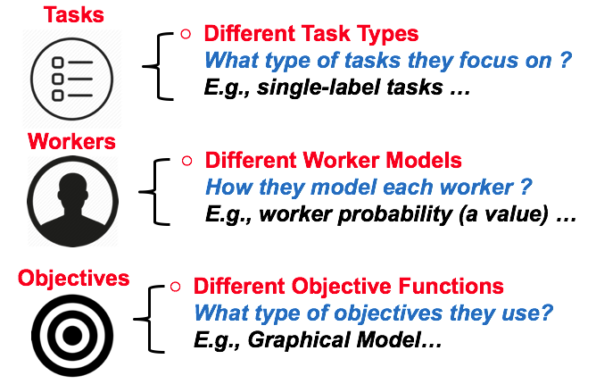
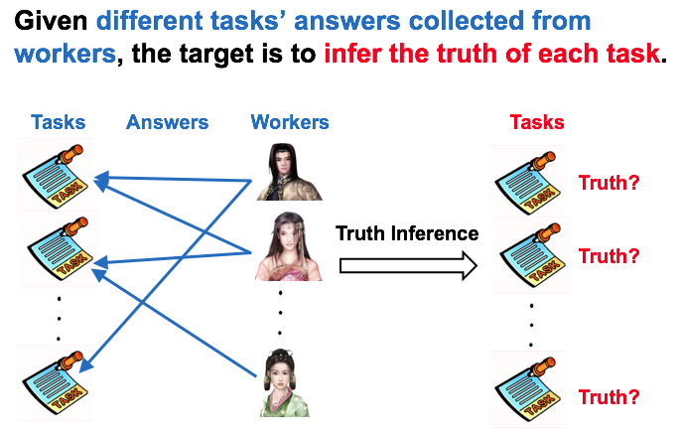
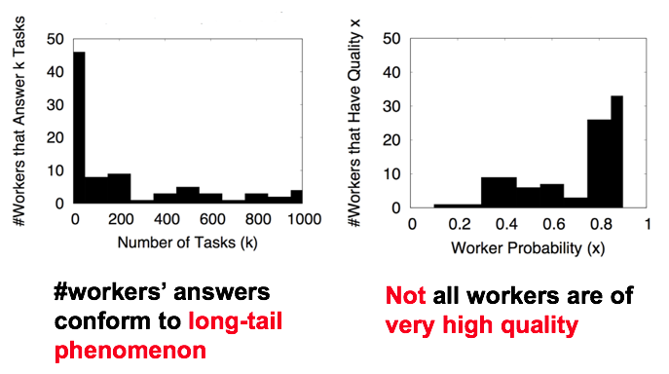
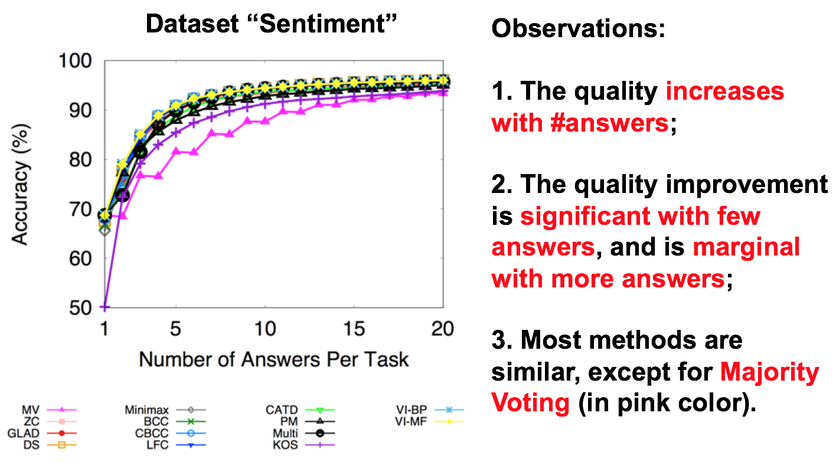
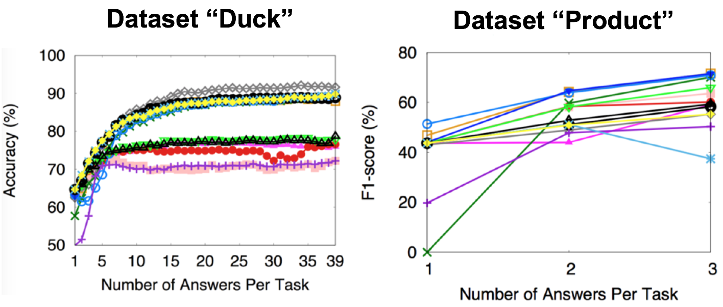
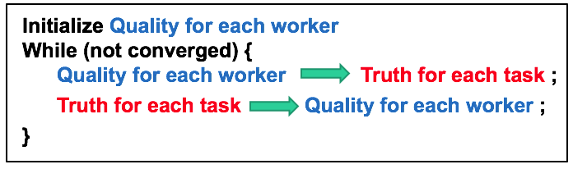
Truth Inference in Crowdsourcing: Is the Problem Solved?
Yudian Zheng*, Guoliang Li#, Yuanbing Li#, Caihua Shan*, Reynold Cheng*
*University of Hong Kong, #Tsinghua University
Motivating Example
Part II. Comparisons
Truth Inference Definition
Part III. Experiments and Analysis
Observations
Change of Quality with the #Answers
Three Goals
What are the similarities in existing works?
What are the differences in existing works?
Any suggestions to use in practice?
Part I. Unified Framework
Input: Workers’ Answers for all tasks
Algorithm Framework

Slide 2
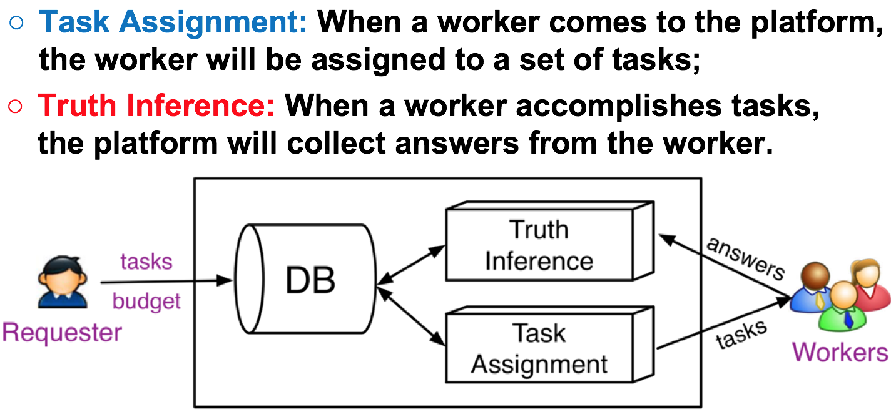
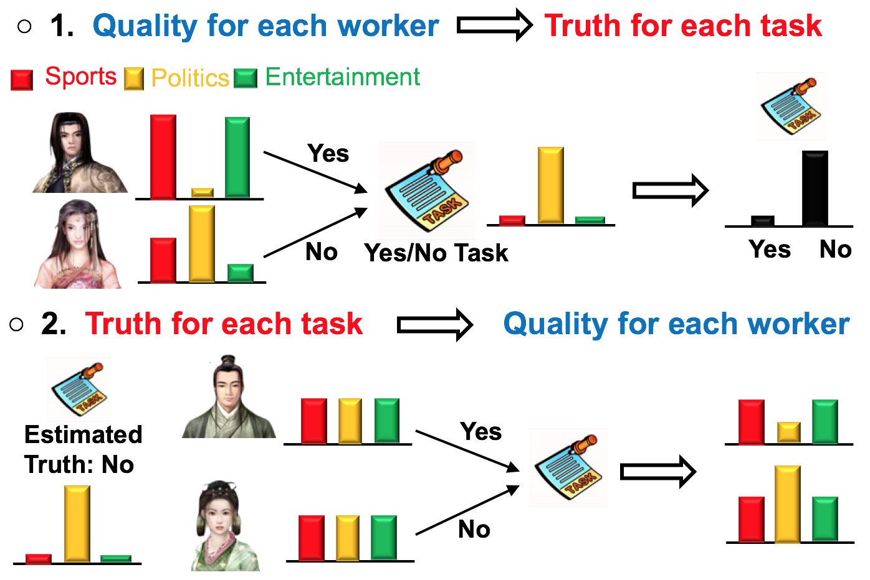
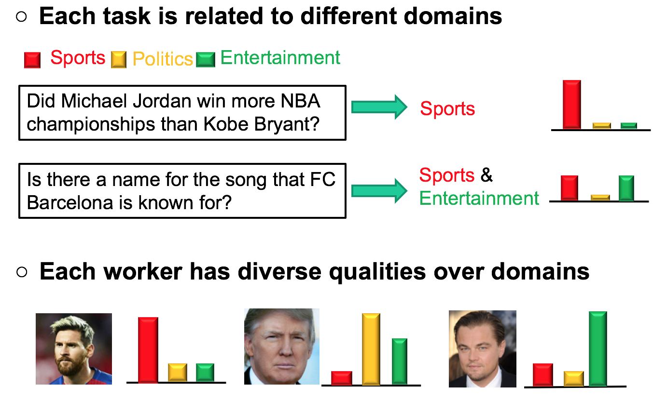
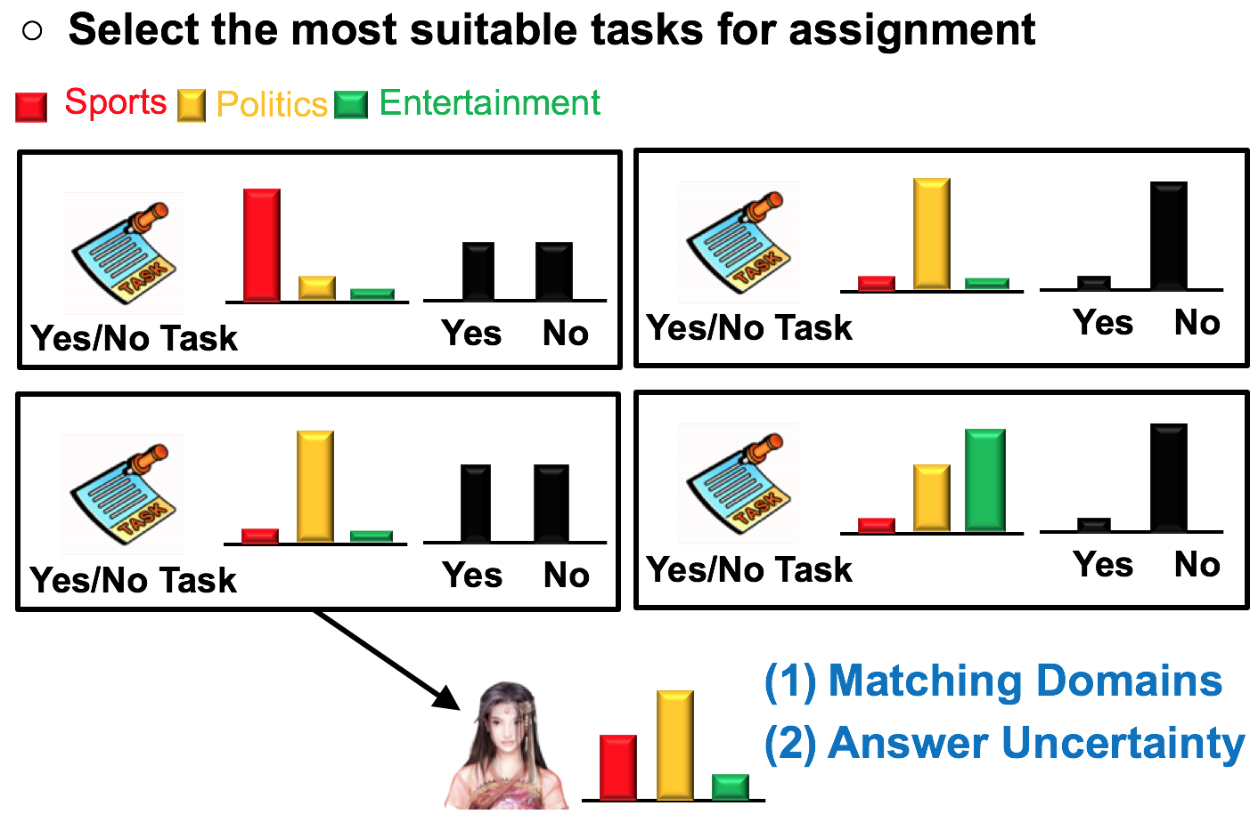
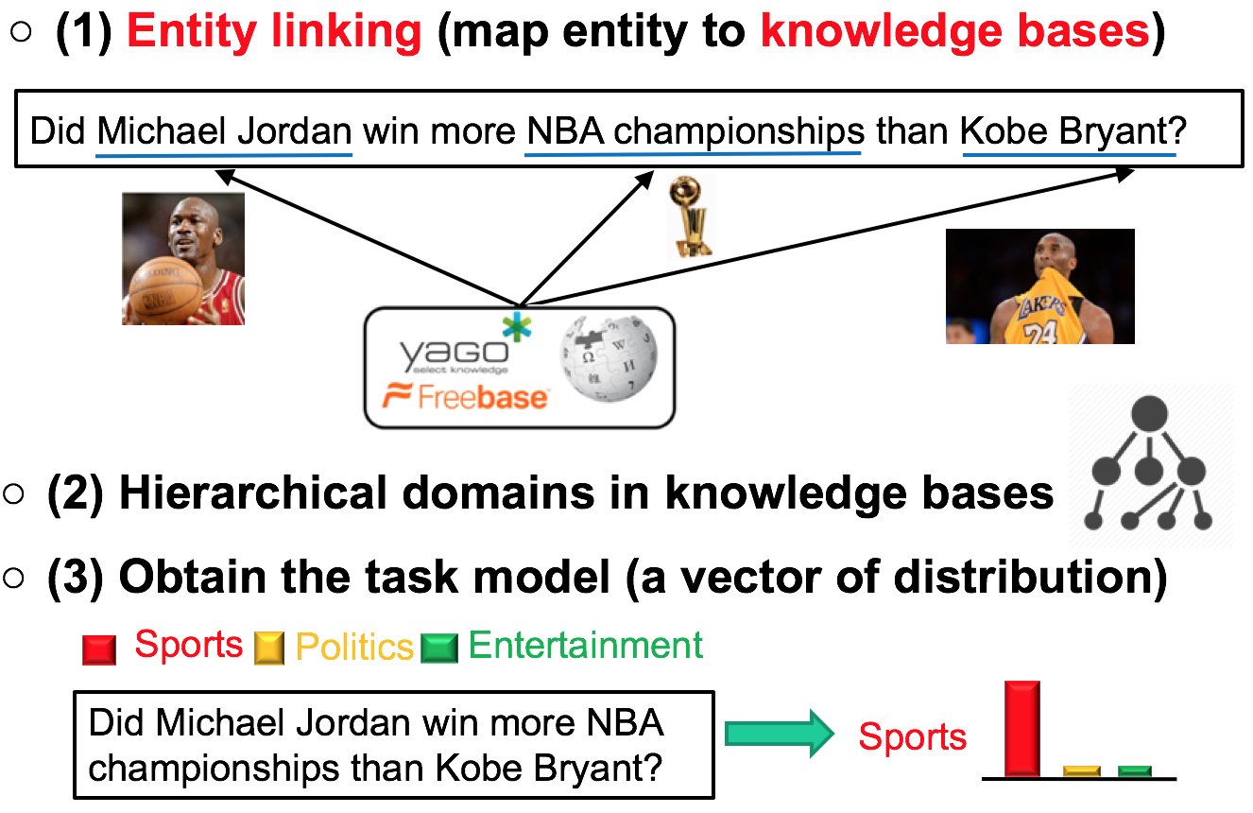
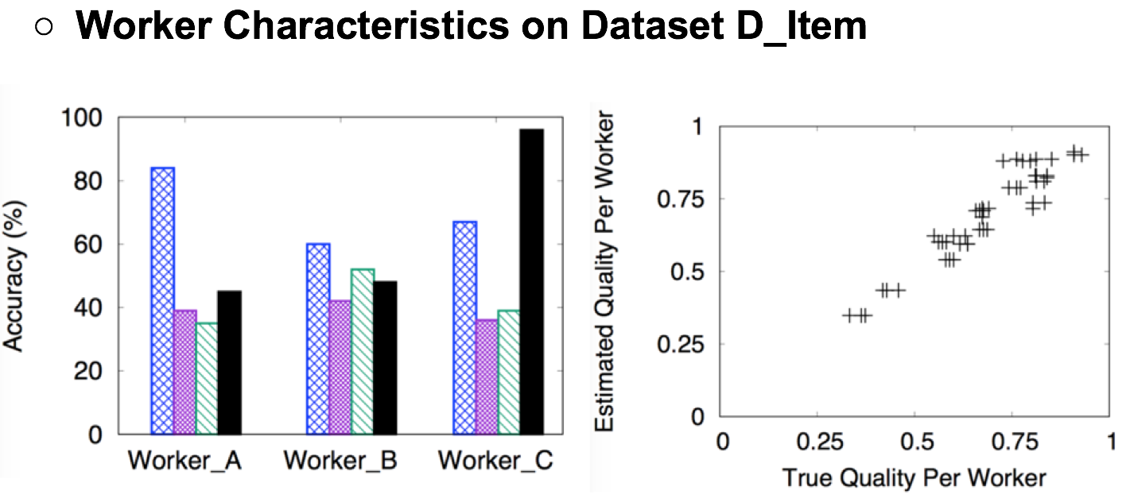
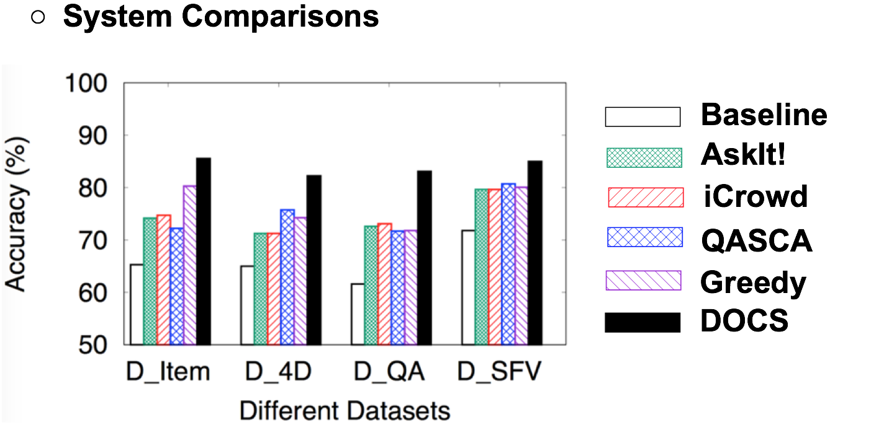
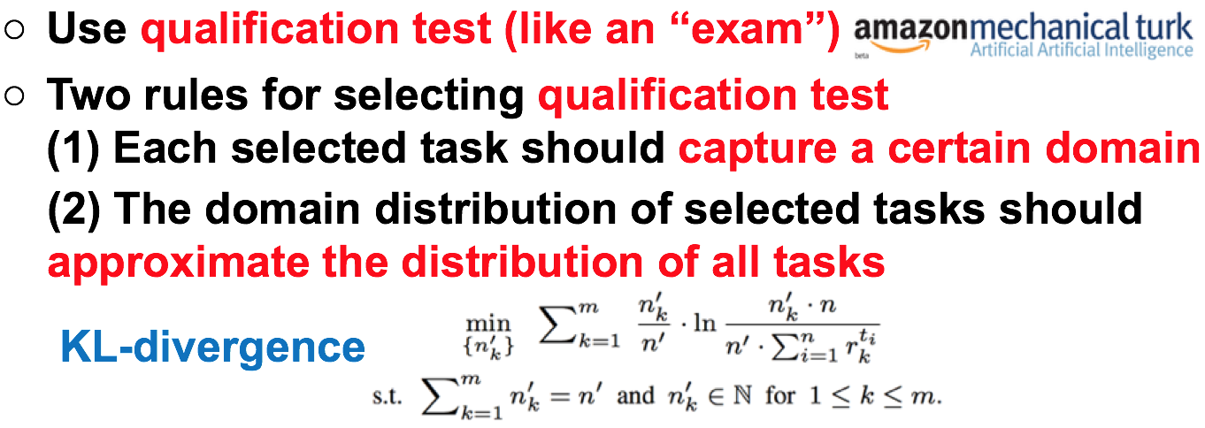
DOCS: A Domain-Aware Crowdsourcing System Using Knowledge Bases
Yudian Zheng*, Guoliang Li#, Reynold Cheng*
*University of Hong Kong, #Tsinghua University
Crowdsourcing Workflow
Truth Inference
Existing Works Fail in QA Tasks
Task Assignment
Build Domain Aware Task Model
Experiments
Build Domain Aware Worker Model

